Slide 1
Moses Escapes from Egypt
EXODUS

Slide 2
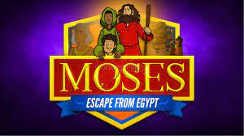
Movie Time
Watch the movie and answer questions to get stamps!

Slide 3
Movie Time
Watch the movie and answer questions to get stamps!

Slide 4
True or False
Moses identified himself with the Israelites.
God approves of murder when a situation is unfair.
The Pharaoh wanted to kill him for killing an Egyptian
God had forgotten the Israelites.
Notes:
Moses identified himself with the Israelites. T
God had forgotten the Israelites. F
God approves of murder when a situation is unfair. F
The Pharaoh wanted to kill him for killing an Egyptian T

Slide 5
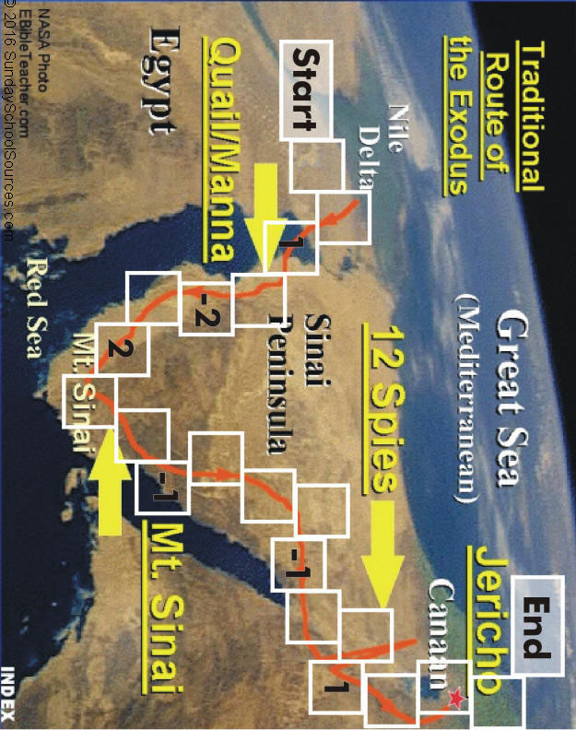

Slide 6
QUIZ
1.) Why did the king of Egypt put the children of Israel into bondage?
He was slothful and wanted other people to do his work
He wanted to keep them from multiplying; he feared that they could overtake the Egyptians
He hated Jacob and all of his family
He wanted to show the children of Israel that his gods were more powerful than the God of Israel
2.) Which line of Israel's family bore Moses?
Joseph
Benjamin
Judah
Levi
Notes:
What feeling caused Moses to flee Egypt? fear for his life

Slide 7
QUIZ
3.) Who adopted Moses?
The daughter of Pharaoh
Moses' sister
Zipporah
Shiphrah
4.) Why did Moses kill the Egyptian?
The Egyptian was beating a Hebrew
The Egyptian wanted to assassinate Pharaoh
The Egyptian hated Moses
The Egyptian was escaping Pharaoh's palace with stolen goods
Notes:
What feeling caused Moses to flee Egypt? fear for his life

Slide 8
QUIZ
5.) To where did Moses flee from being punished for killing the Egyptian?
The home of his Hebrew birth mother
The land of Canaan
The wilderness
The land of Midian
6.) Who was Moses' wife?
Puah
Shiphrah
Pharaoh's daughter
Zipporah
Notes:
What feeling caused Moses to flee Egypt? fear for his life

Slide 9
QUIZ
7.) What did God tell Moses to do before approaching the burning bush?
Wash his hands
Set aside his staff
Take off his shoes
Cover the crown of his head
8.) What was Moses' concern about his ability to lead the children of Israel?
He was slow of speech
He was wicked
He was too young for such a great task
He was crippled
Notes:
What feeling caused Moses to flee Egypt? fear for his life

Slide 10
QUIZ
9.) Who was to be Moses' spokesperson?
Zipporah
His Hebrew mother
His brother, Aaron
Jethro
10.) What did Aaron turn his rod into?
A hoe
A serpent
A whip
A sword
Notes:
What feeling caused Moses to flee Egypt? fear for his life

Slide 11
QUIZ
11.) Each of these creatures plagued Egypt EXCEPT:
Lice
Frogs
Flies
Locusts
Serpents
12.) Which of these plagues did the Lord NOT inflict on the Egyptians?
The transformation of water into blood
Boils breaking out on the skin of the people
Raining down of hail and fire
Food turning into stones
All cattle die
Three days of darkness
Notes:
What feeling caused Moses to flee Egypt? fear for his life

Slide 12
QUIZ
13.) What did the children of Israel do to protect their firstborn sons from being killed in the Lord's last plague on Egypt?
Carve a cross into the door of their home
Hang a talisman in every window of their homes
Keep the fireplace burning all night long
Smear lamb's blood around the door frame
14.) Which of these food items was NOT included in the Passover feast?
Olives
Lamb
Unleavened bread
Bitter herbs
Notes:
What feeling caused Moses to flee Egypt? fear for his life

Slide 13
QUIZ
15.) True or False?: The children of Israel had to suffer from all of the same plagues as the Egyptians did.
the Lord wanted to test the faith and loyalty of the children of Israel
the Lord put a difference between the Egyptians and the children of Israel
16.) The Lord showed the children of Israel which way to travel in the wilderness by using:
a white ox
the direction of the wind
the sun (by day) and the moon and stars (by night)
a pillar of cloud (by day) and of fire (by night)
17.) Through which body of water did the children of Israel pass safely?
The Sea of Galilee
The Red Sea
The Nile River
The Dead Sea
Notes:
What feeling caused Moses to flee Egypt? fear for his life

Slide 14
“Put your trust in God!
God's ways are not like ours, but they work.”
Notes:
God's ways are not like ours, but they work.

Slide 15
“Do not be afraid
See the salvation of the Lord”
~Exodus 14:13
Notes:
God's ways are not like ours, but they work.

